Slide 1
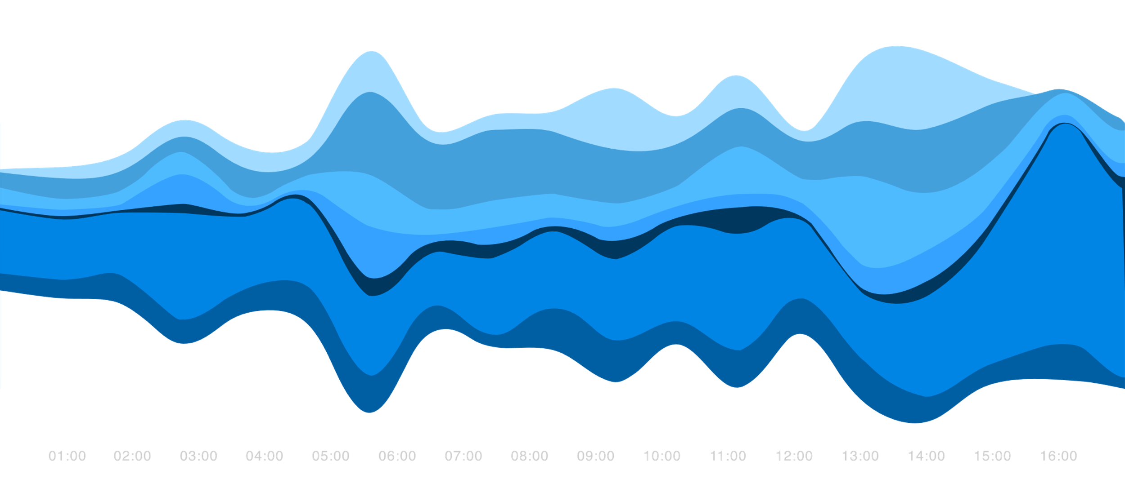
STREAM GRAPH

Slide 2
INTRODUCTION
A stream graph - type of stacked area graph which is displaced around a central axis, resulting in a flowing, organic shape.
Stream graphs display the changes in data over time of different categories through a river-like stream.
Pleasing and more engaging to look at.

Slide 3
STACKED AREA GRAPH
Month | Apples | Bananas | Cherries | Dates
1/2015 | 3840 | 1920 | 960 | 400
2/2015 | 1600 | 1440 | 960 | 400
3/2015 | 640 | 960 | 640 | 400
4/2015 | 320 | 480 | 640 | 400
[[0,3840], [0,1600], [0,640], [0,320]] // apples
[[3840,5760], [1600,3040],[640,1600], [320,800]] // bananas
[[5760,6720], [3040,4000], [1600,2240], [800,1400]] // cherries
[[6720,7120], [4000,4400], [2240,2640], [1440,1840]] //dates

Slide 4
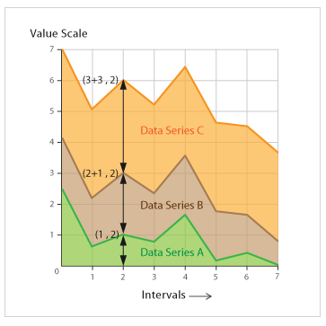
STACKED AREA GRAPH

Slide 5
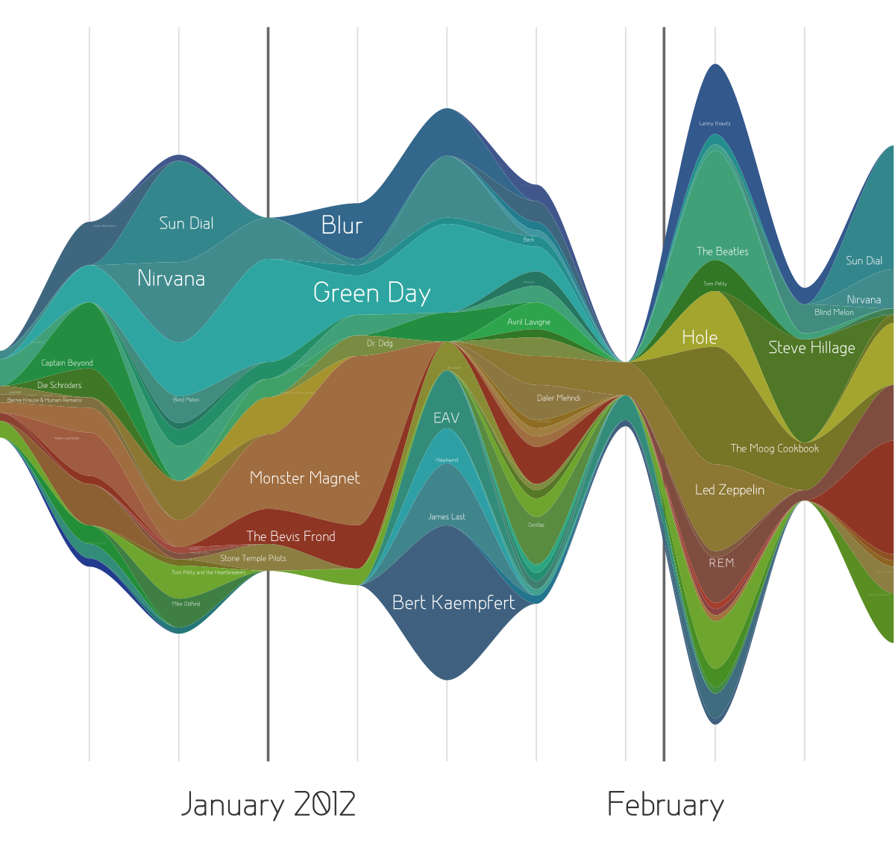
HISTORY
Stream graph got popularized in February 2008, published by New York Times.

Slide 6
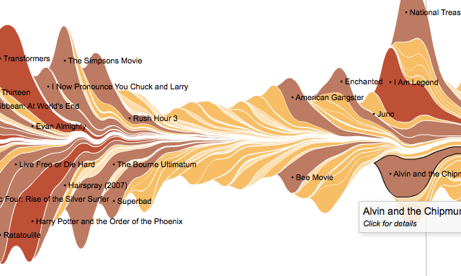
HISTORY
Found by Lee Byron and Wattenberg.

Slide 7
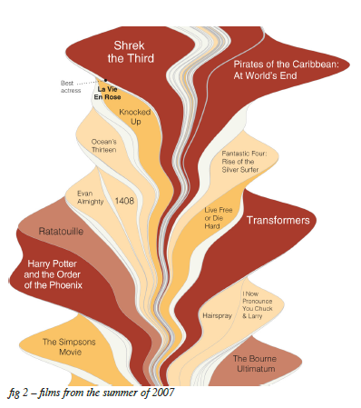

Slide 8
STREAM GRAPH
Ideal for displaying high-volume datasets, in order to discover trends and seasonality over time across a wide range of categories.
Size of each individual stream shape is proportional to the values in each category.
The axis that a Stream Graph flows parallel to, is used for the timescale.
Categories are distinguished using colours.
Seasonal peaks and troughs in the stream shape can suggest periodic pattern.

Slide 9
STREAM GRAPH
A Stream Graph could also be used to visualise the volatility for a large group of assets over a certain period of time.
Downside - they suffer from legibility issues, as they are often very cluttered with large datasets. The categories with smaller values are often drowned out to make way for categories with much larger values, making it impossible to see all the data.
Impossible to read the exact values.
Reserved to audiences who don’t intend to spend much time deciphering the graph and exploring its data.
Better for giving a more general view of the data.

Slide 10
POINTS TO CONSIDER
Baseline
Colour choice
Layer labelling
Layer order
We model our time series as a set of n real-valued non-negative functions, f1,f2,….,fn.
We refer to the baseline function that defines the bottom of the stacked graph as g0.

Slide 11

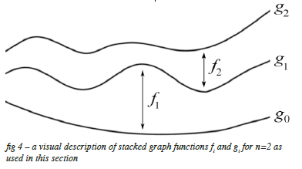

BASELINE APPROACH -1
The top of the layer corresponding to the i^{th} time series fi is therefore given by the function gi, where

Slide 12



BASELINE APPROACH -2
stack = np.cumsum(y, axis=0, dtype=np.promote_types(y.dtype, np.float32))
first_line = -np.sum(y, 0) * 0.5
stack += first_line[None, :]

Slide 13




BASELINE APPROACH -3
m = y.shape[0]
first_line = (y * (m - 0.5 - np.arange(m)[:, None])).sum(0)
first_line /= -m
stack += first_line

Slide 14


BASELINE APPROACH - 4

Slide 15
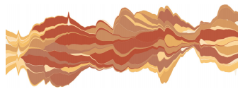
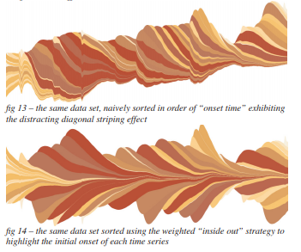

Slide 16
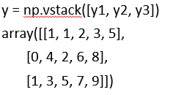

EXAMPLE
x = [1, 2, 3, 4, 5]
y1 = [1, 1, 2, 3, 5] #Fibonacci
y2 = [0, 4, 2, 6, 8] #even
y3 = [1, 3, 5, 7, 9] #odd
labels = ["Fibonacci ", "Evens", "Odds"]
stack = np.cumsum(y, axis=0, dtype=np.promote_types(y.dtype, np.float32))

Slide 17

Example:
sym:
first_line = -np.sum(y, 0) * 0.5
stack += first_line[None, :]
wiggle:
m = y.shape[0] # m=3
first_line = (y * (m - 0.5 - np.arange(m)[:, None])).sum(0)
first_line /= -m # array([-1. , -3.33333333, -3.5 , -6.66666667, -9.66666667]
stack += first_line # array([[ -2. , -9.66666667, -9.5, -18.33333333, -25.33333333],
[ -2. , -5.66666667, -7.5, -12.33333333, -17.33333333],
[ -1. , -2.66666667, -2.5, -5.33333333, -8.33333333]])

Slide 18
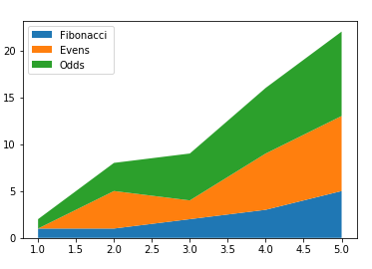
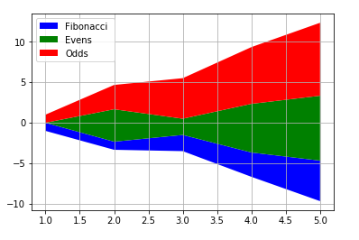
fig, ax = plt.subplots()
ax.grid(zorder=0)
ax.stackplot(x, y, baseline='sym’, labels=labels, colors=['b','g','r'])
ax.legend(loc='upper left')
plt.show()
fig, ax = plt.subplots()
ax.stackplot(x,y,baseline='zero',labels=labels)
ax.legend(loc='upper left')
plt.show()

Slide 19
REFERENCES
https://matplotlib.org/3.1.1/_modules/matplotlib/stackplot.html
https://matplotlib.org/gallery/lines_bars_and_markers/stackplot_demo.html
https://classes.engineering.wustl.edu/cse557/spring2017/assignments/stackTutorial.html
http://leebyron.com/streamgraph/stackedgraphs_byron_wattenberg.pdf

Slide 20
THANK YOU

